Slide 1
Northwind Discounts
Notes:
Welcome! Today we are going to look at how the Northwind Traders are taking advantage of discounts.

Slide 2

Problem Statement
Everyone loves getting a discount, but what do they accomplish for us?
Notes:
Who doesn’t love getting a good deal? While discounts are great for customers, they can easily represent lost revenue for vendors. By using discounts, are we generating sales or diminishing our returns?

Slide 3

Business Value
Increase sales revenue
Decrease cost
Full utilization of sales team
Notes:
We have three goals with this project. First, we want to increase our sale revenue. We want to explore if our discounts lead to higher sales and customer retention. If we can sell more product, then we can generate more profit.
Second, we want to decrease our costs. If we can are using discounts effectively, they can be used to rotate stock, driving down any perishable food costs.
And finally, we want to examine how well our employees utilize discounts. Are they able to push discounted products effectively, or will they require training to fully take advantage?

Slide 4
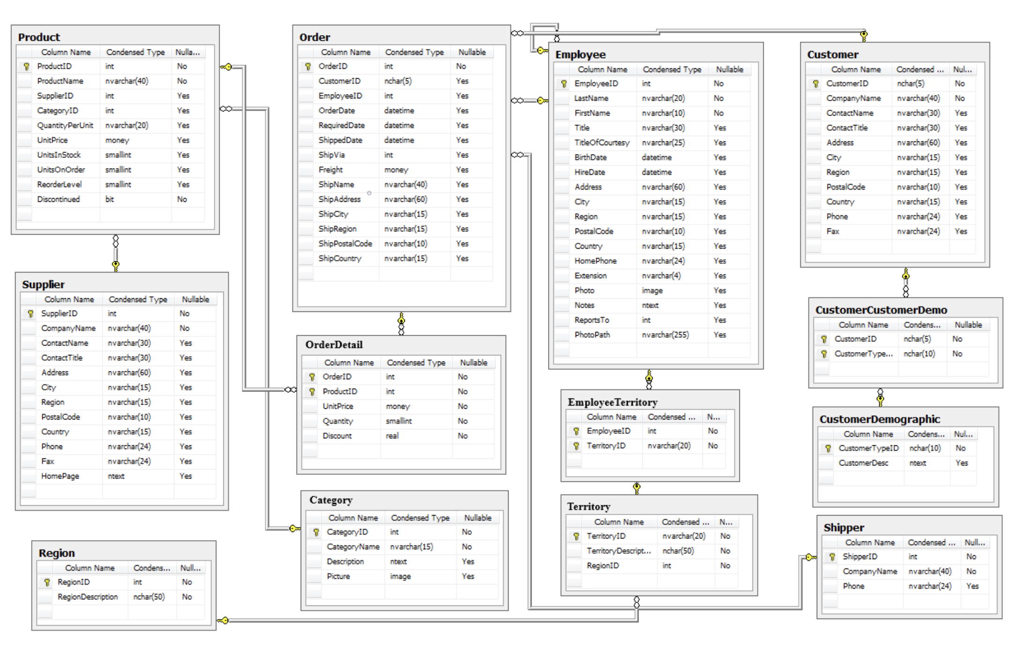
Northwind Database

Slide 5
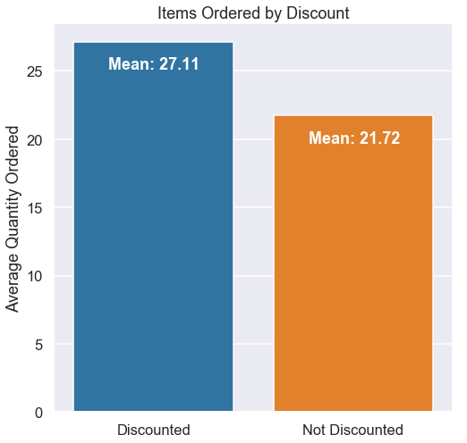
Findings
Discounted items sell at a higher rate.
Notes:
So, what did we find when we looked at our sales data? First, we discovered that discounted items do sell at a higher rate.

Slide 6
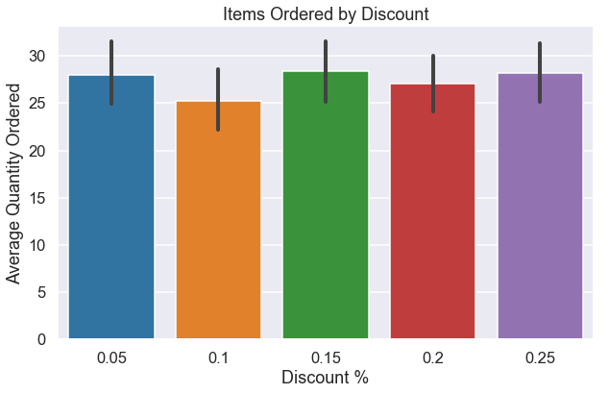
Findings
Discounted items sell at a higher rate.
Higher discounts do not lead to higher sales.
Notes:
So, what did we find when we looked at our sales data? First, we discovered that discounted items do sell at a higher rate.

Slide 7
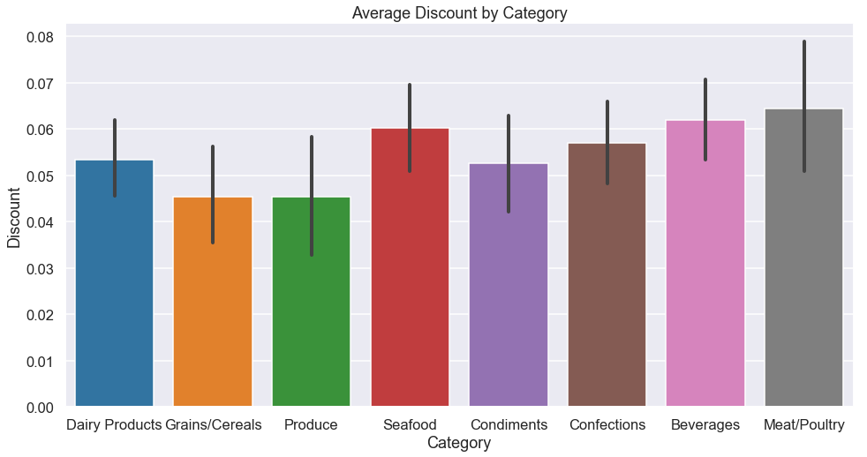
Findings
Discounts are linked to customer retention.
Discounts are spread evenly across product categories.
Discounted items sell at a higher rate.
Higher discounts do not lead to higher sales.
Some employees are better at moving discounted products.
Notes:
While we are selling more discounted items, we found that the actual size of the discount was unimportant.
Second, we found that discounts were linked to customer retention. Customers who receive a higher discount are more likely to order again, and more likely to spend more at Northwind Traders.
We also found that discount levels were consistent between product categories. Discounts are not being targeted to individual products.
And lastly, we found that some employees are more consistent when selling discounted products.

Slide 8
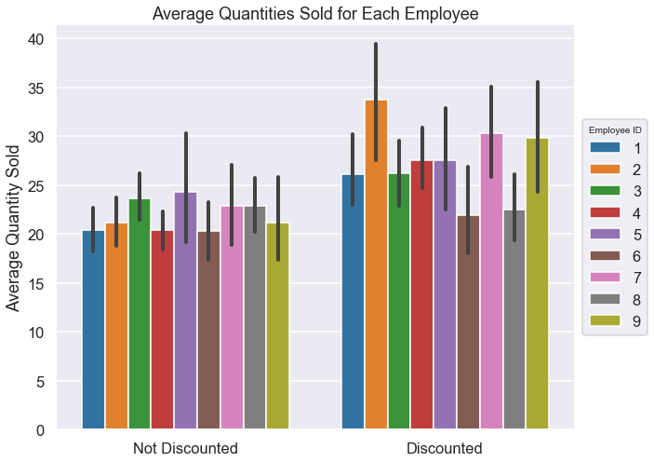
Notes:
All employees have similar averages of products sold while non-discounted, however certain employees are significantly more likely to sell products when discounted.

Slide 9

Recommendations
Employee training and incentive program
Targeted discounts to move surplus product
Customer reward programs
Notes:
We have prepared some methods to capitalize on these findings. Creating an employee training program will allow the sales staff to learn tips and strategies on how to successfully utilize discounts to generate sales.
Next, we should start using discounts to target products which can generate more revenue. By discounting products that sell for higher prices we can sell more of those products. Similarly, by focusing products on categories that spoil faster, we can turn more product and decrease spoilage costs.
We also recommend creating a tuned customer reward program. Providing a tiered rewards program will encourage customers to come back to Northwind Traders. This can result in higher sales averages and more orders.

Slide 10

Future Work
Explore employee sales to expand training program
Target sales data by region
Maximize discount prices
Notes:
So, where can we go from here? I would suggest looking into expanding a potential mentoring program. Employees can teach each other about more than how they utilize discounts. We could look at how they sell different types of products, or how they sell to different types of customers. This is a strong step in creating a consistent and efficient sales team.
We should also begin to look at how our sales data breaks down by region. We can provide tailored service and pricing to regionalized markets, maximizing our profit margins.
Last, and perhaps most strongly, I suggest that we begin to fine tune discount levels. We have many discount levels that are not being used efficiently to generate sales. If a higher discount level is not generating profit, then it is not being used effectively.

Slide 11
Thank You!
Notes:
Thank you for your time today! Please feel free to ask any questions you may have, and if any of you would like a closer look at the project, I would be happy to provide it.

